Slide 1
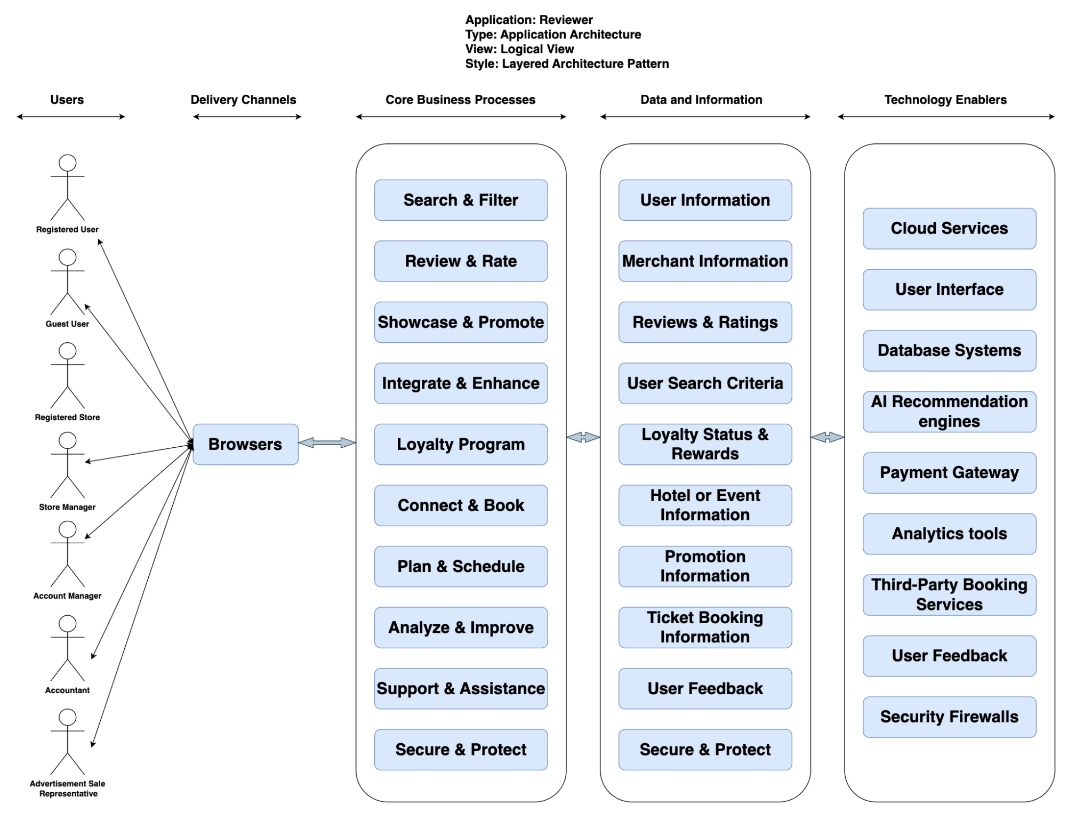
Application: Reviewer
Type: Application Architecture
View: Logical View
Style: Layered Architecture Pattern

Slide 2
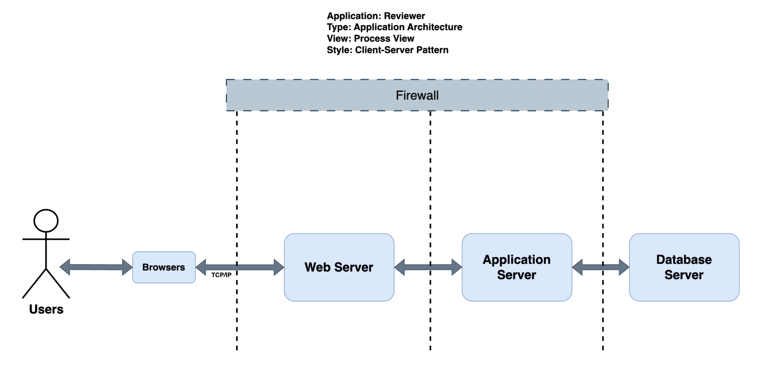

Slide 3
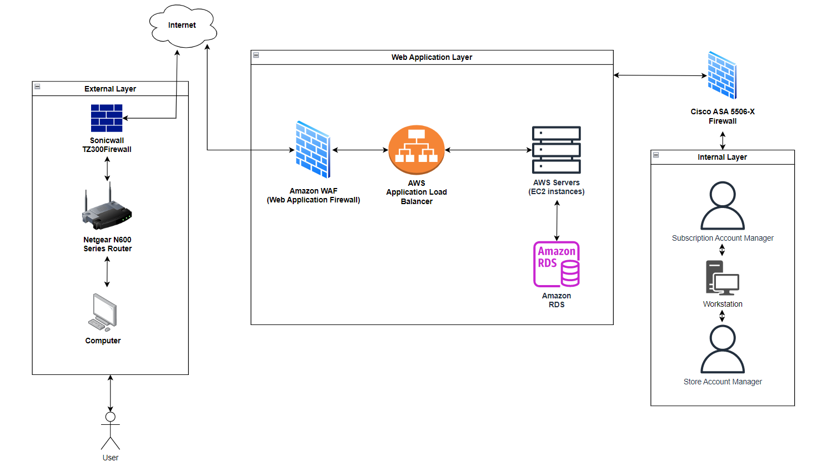
Application: Reviewer
Type: Application Architecture
View: Physical View
Style: Layered Architecture Pattern

